Slide 1
3.2 Model-based decomposition
ESTP Training
05-07 October 2026

Slide 2
0. Outline
Unobserved component models
  STS, AMB
SEATS algorithm
Estimation
  MMSE estimators, algorithms
Analysis
  Finite / infinite approaches
SEATS in JD+
  Parameters, non decomposable models, estimation

Slide 3
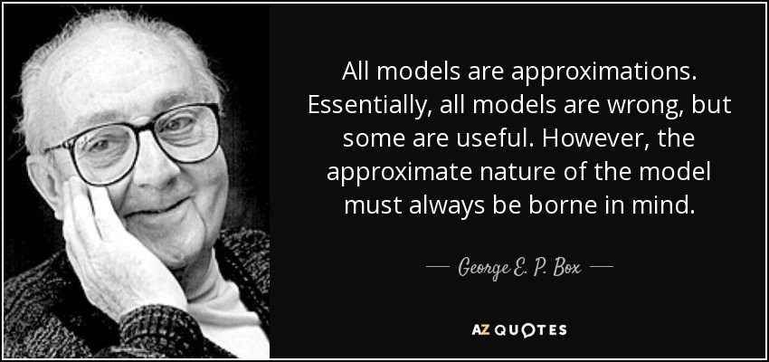
Always keep in mind…

Slide 4
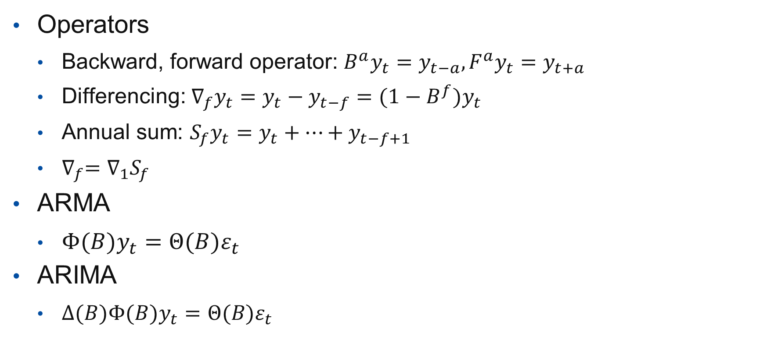
0.1 Some notations
Operators
  Backward, forward operator: $B^{a}y_{t}=y_{t−a},F^{a}y_{t}=y_{t+a}$
  Differencing: $∇_{f}y_{t}=y_{t}−y_{t−f}=(1−B^{f})y_{t}$
  Annual sum: $S_{f}y_{t}=y_{t}+⋯+y_{t−f+1}$
  $∇_{f}=$ $∇_{1}S_{f}$
ARMA
  $Φ(B)y_{t}=Θ(B)ε_{t}$
ARIMA
  $∆(B)Φ(B)y_{t}=Θ(B)ε_{t}$

Slide 5
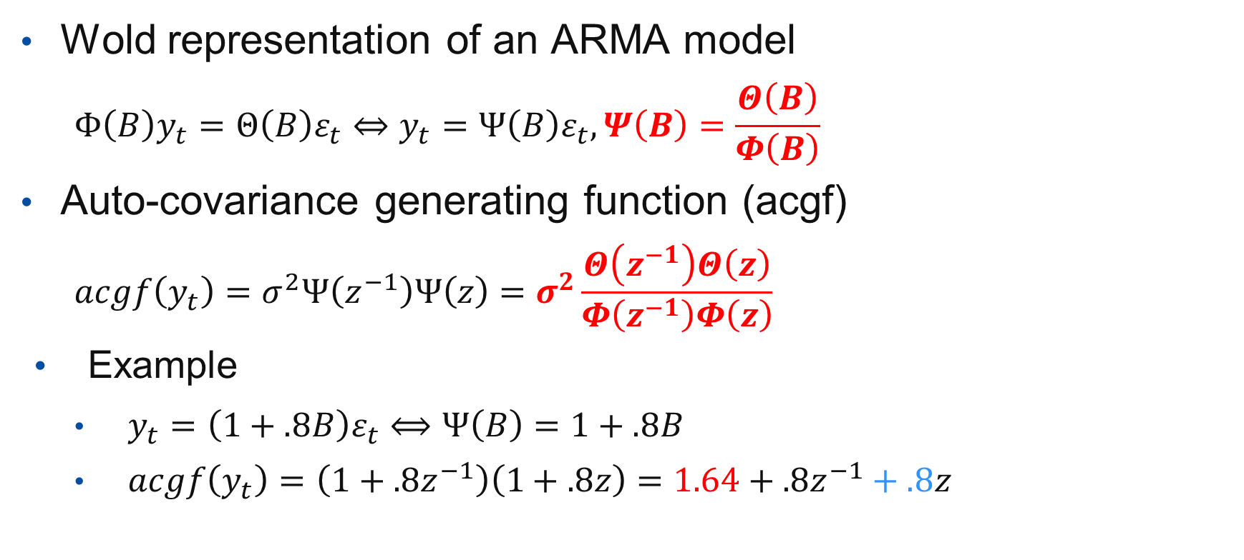
0.2 Useful tools
Wold representation of an ARMA model
  $$Φ\left(B\right)y_{t}=Θ\left(B\right)ε_{t}⇔y_{t}=Ψ\left(B\right)ε_{t},Ψ\left(B\right)=\frac{Θ\left(B\right)}{Φ\left(B\right)}$$
Auto-covariance generating function (acgf)
  $$acgf\left(y_{t}\right)=σ^{2}Ψ\left(z^{−1}\right)Ψ\left(z\right)=σ^{2}\frac{Θ\left(z^{−1}\right)Θ\left(z\right)}{Φ\left(z^{−1}\right)Φ\left(z\right)}$$
Example
  $y_{t}=\left(1+.8B\right)ε_{t}⟺Ψ\left(B\right)=1+.8B$
  $acgf\left(y_{t}\right)=$ $\left(1+.8z^{−1}\right)\left(1+.8z\right)=1.64+.8z^{−1}+.8z$

Slide 6
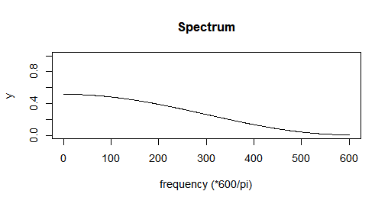
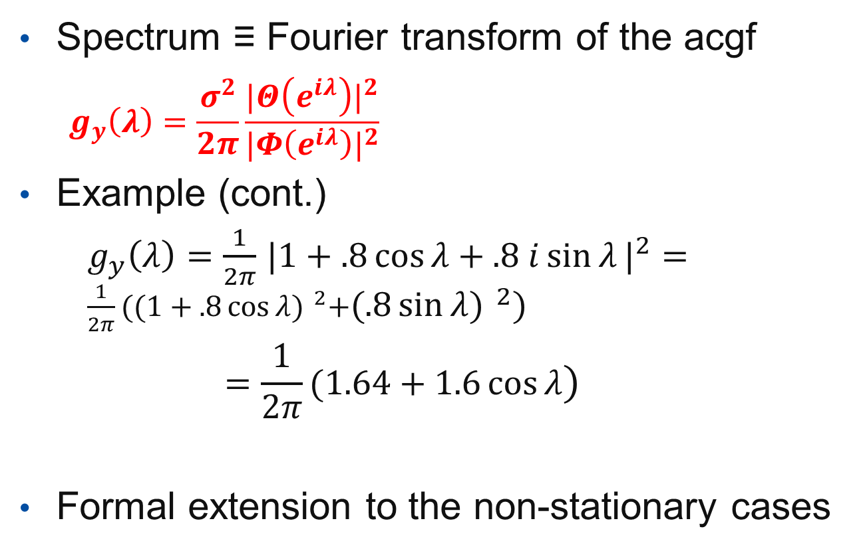
0.2 Useful tools
Spectrum ≡ Fourier transform of the acgf
  $$g_{y}\left(λ\right)=\frac{σ^{2}}{2π}\frac{{|Θ\left(e^{iλ}\right)|}^{2}}{{|Φ\left(e^{iλ}\right)|}^{2}}$$
Example (cont.)
    $g_{y}\left(λ\right)=\frac{1}{2π}$ ${|1+.8\cos{λ}+.8 i\sin{λ}|}^{2}=$ $\frac{1}{2π}{((1+.8\cos{λ}) }^{2}+{(.8\sin{λ}) }^{2})$
    $$=\frac{1}{2π}(1.64+1.6\cos{λ})$$
Formal extension to the non-stationary cases

Slide 7
1. Unobserved components model
Principle
  The different components of the series are “defined” by [ARIMA] models
  The components are independent
  The sum of the model of the components is the model of the series

Slide 8





1.1 Unobserved components model (STS)
Theoretical model
Series($θ_{T,S,I})$
Trend($θ_{T})$
Seasonal($θ_{S})$
Irregular($θ_{I})$
<=
+
+
Independent
$${\hat{θ}}_{T,S,I}$$
Observed time series

Slide 9
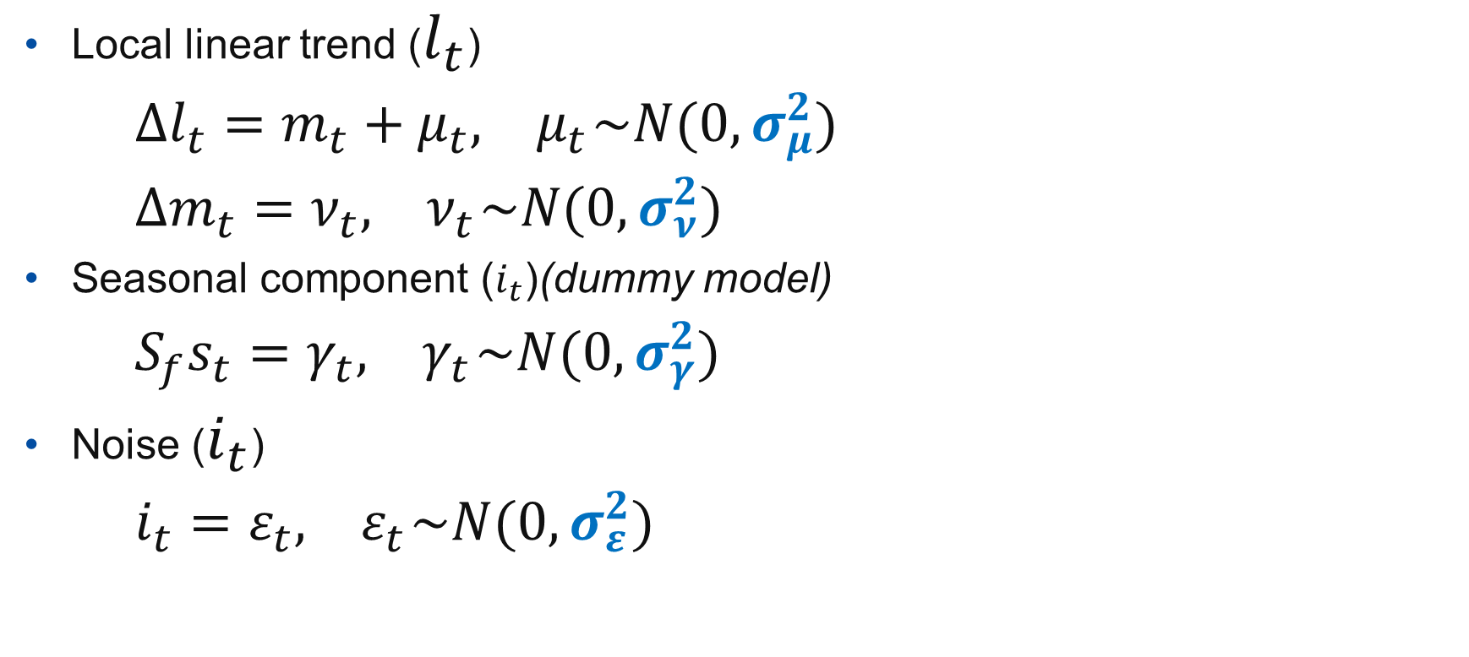
1.1.1 Basic structural model (STS)
Local linear trend ($l_{t}$)
    $$∆l_{t}=m_{t}+μ_{t},{ μ}_{t}\sim N(0, σ_{μ}^{2})$$
    $$∆m_{t}=ν_{t},{ ν}_{t}\sim N(0, σ_{ν}^{2})$$
Seasonal component ($i_{t}$)(dummy model)
    $$S_{f}s_{t}=γ_{t},{ γ}_{t}\sim N(0, σ_{γ}^{2})$$
Noise ($i_{t}$)
    $$i_{t}=ε_{t},{ ε}_{t}\sim N(0, σ_{ε}^{2})$$

Slide 10





1.2 Unobserved components model (AMB)
Theoretical model
Series($θ_{Y})$
Trend($θ_{Y})$
Seasonal($θ_{Y})$
Irregular($θ_{Y})$
=>
+
+
Independent
$${\hat{θ}}_{Y}$$
Observed time series

Slide 11
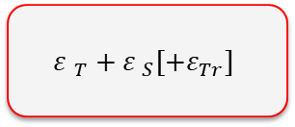
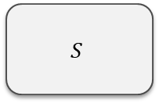
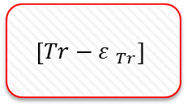



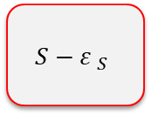
2.1 SEATS algorithm
Factorization based on the auto-regressive part (AR and I)
ARIMA
$$T$$
$$S$$
$\left[Tr\right]$
See:
Gomez and Maravall…
Canonical decomposition
$$T−{ε }_{T}$$
$$S−{ε }_{S}$$
$$\left[Tr−{ε }_{Tr}\right]$$
$${ε }_{T}+{ε }_{S}[+ε_{Tr}]$$

Slide 12
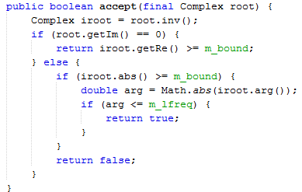

2.2 SEATS Algorithm. Details (I)
ARIMA:
$$Φ\left(B\right)Δ\left(B\right)y_{t}=Θ(B)ε_{t}$$
Factorization of the AR polynomial:
    $$Φ\left(B\right)Δ\left(B\right)=\prod{(1−α_{i}B)}$$
  Trend-cycle
    $α_{i} real,$
      $α_{i}≥k$
    $α_{i} complex,$
      $\left|α_{i}\right|≥k, arg(α_{i})≤c$
    $$\left(c=\frac{π}{s}\right)\sim cycle length≥two years$$
TrendCycleSelector.java

Slide 13
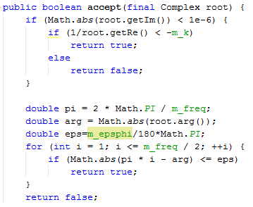

  Seasonal
    $α_{i} real,$
      $α_{i}<−l$
    $α_{i} complex,$
      $\left|arg\left(α_{i}\right)−f_{s}\right|≤e$
      $$f_{s} seasonal frequency$$
  Transitory (I)
    All other roots
SeasonalSelector.java
Trend boundary | k
Seasonal tolerance (degree) | e
Seasonal boundary | l
Seas.boundary (unique) | l (no seasonal part)

Slide 14
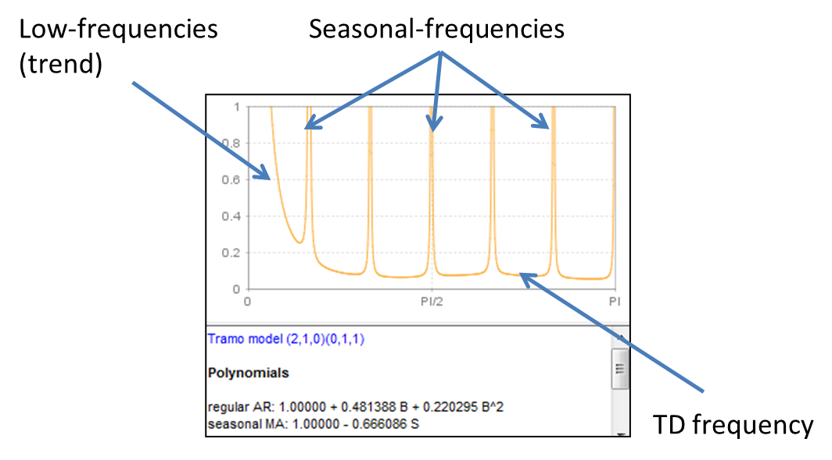
2.3 SEATS = spectral decomposition
Splitting of the spectrum following the different « types » of frequencies

Slide 15
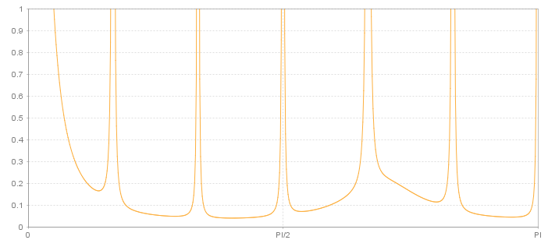
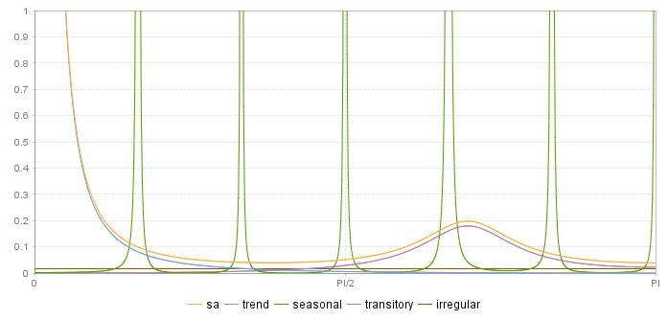


2.3 SEATS = spectral decomposition
$$S_{Y}=S_{T}+S_{S}+S_{Tr}+S_{I}$$
$$S_{SA}=S_{T}+S_{Tr}+S_{I}=S_{Y}−S_{S}$$
Independent components !

Slide 16
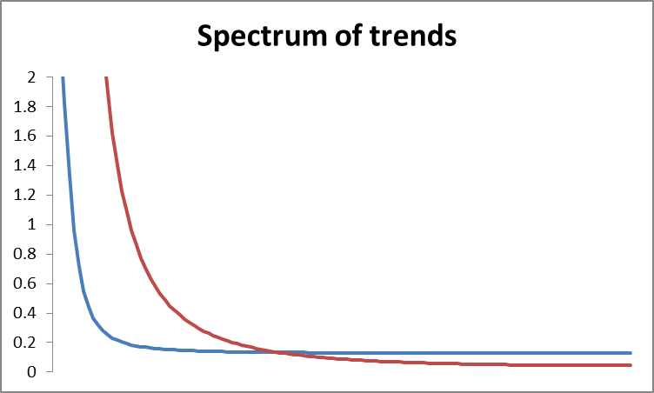
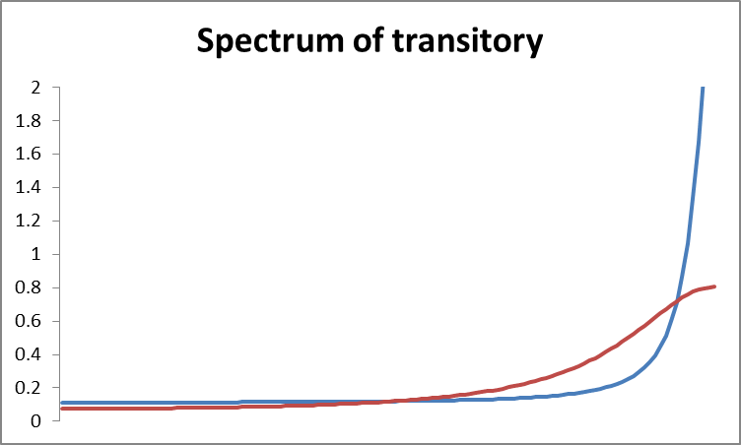
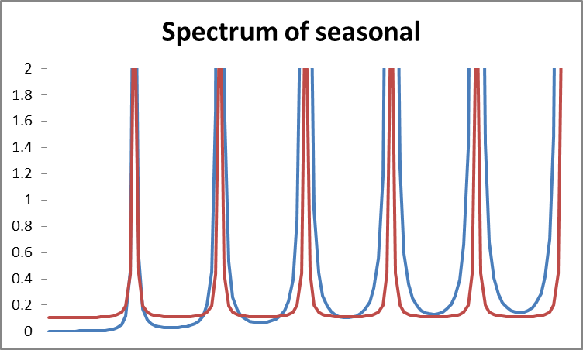
2.3 SEATS = spectral decomposition
Smoother trend
Switchback pattern
More stable seasonal

Slide 17


3. Estimation of the model
Independant components
Sum of cmps <=> y
Components model
Estimators = Linear transformations of y
MMSE criterion
Components estimators
$\hat{S}=L_{S}Y, \hat{N}=L_{N}Y$
Correlated estimators
Estimation by means of KF, Burman’s, McElroy’s algorithms…
Components estimates
$(\hat{s},\hat{n})=KF(y)$
$…$

Slide 18
3.1 Estimation of the components
STS and AMB → UCARIMA models
  Same estimation algorithms
  Common analysis tools
3 solutions, strictly equivalent (except for SD)
  Burman algorithm (WK filters): legacy and default solution, fastest, rich analysis framework, (semi-)infinite approach
  Kalman smoother: more stable but complex, exact finite properties
  [Matrix computation]: Not available in JD+ 3.x

Slide 19
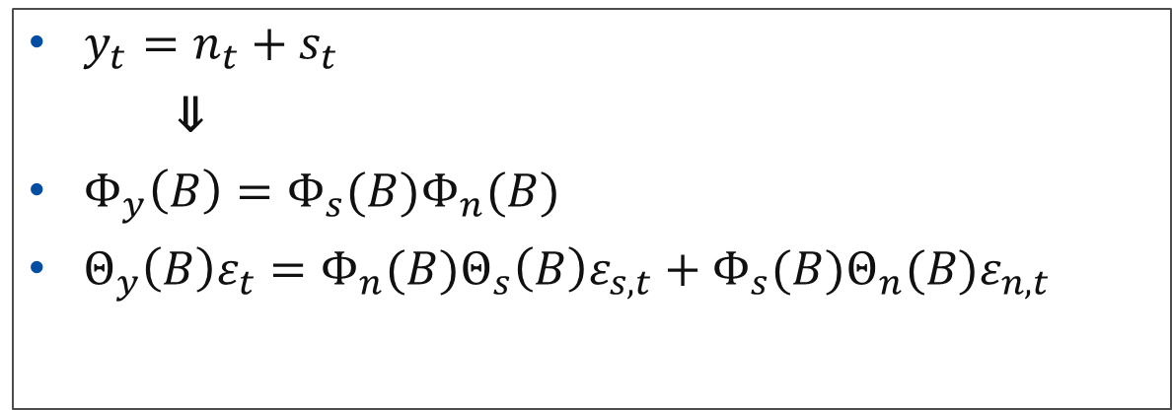
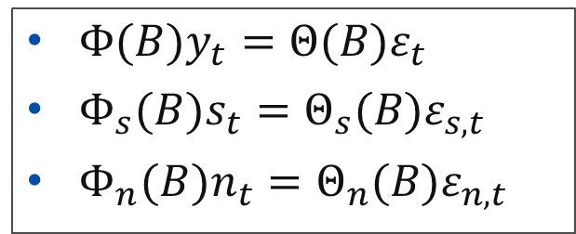
3.1.1 Components
$Φ(B)y_{t}=Θ(B)ε_{t}$
$Φ_{s}(B)s_{t}=Θ_{s}(B)ε_{s,t}$
$Φ_{n}(B)n_{t}=Θ_{n}(B)ε_{n,t}$
$y_{t}=n_{t}+s_{t}$
⇓
$Φ_{y}\left(B\right)=Φ_{s}(B)Φ_{n}(B)$
$Θ_{y}\left(B\right)ε_{t}=Φ_{n}(B)Θ_{s}\left(B\right)ε_{s,t}+{Φ_{s}(B)Θ}_{n}(B)ε_{n,t}$

Slide 20
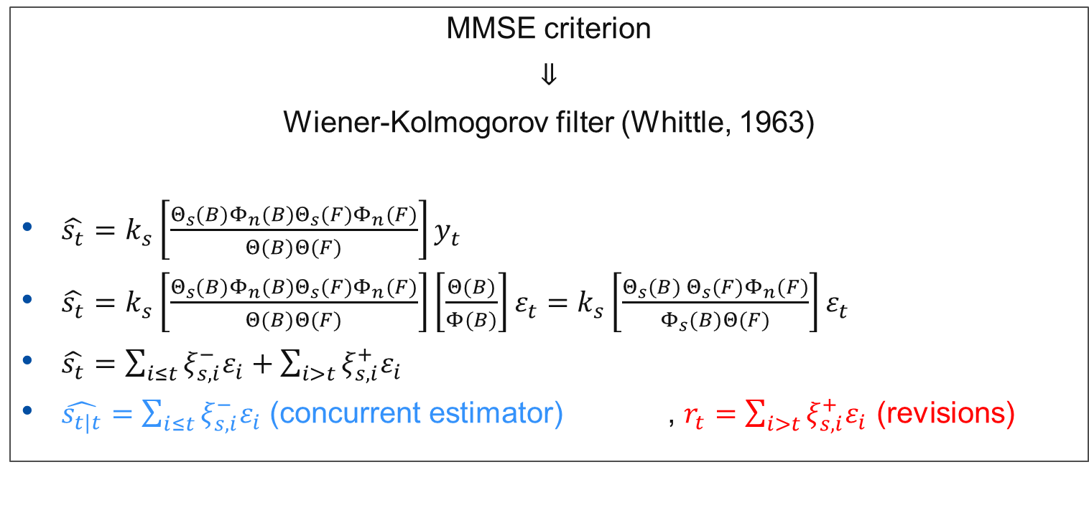
3.1.2 Estimators
MMSE criterion
⇓
Wiener-Kolmogorov filter (Whittle, 1963)
$\hat{s_{t}}=k_{s}\left[\frac{Θ_{s}(B)Φ_{n}(B)Θ_{s}(F)Φ_{n}(F)}{Θ(B)Θ(F)}\right]y_{t}$
$\hat{s_{t}}=k_{s}\left[\frac{Θ_{s}(B)Φ_{n}(B)Θ_{s}(F)Φ_{n}(F)}{Θ(B)Θ(F)}\right]\left[\frac{Θ(B)}{Φ(B)}\right]ε_{t}=$ $k_{s}\left[\frac{Θ_{s}(B) Θ_{s}(F)Φ_{n}(F)}{Φ_{s}(B)Θ(F)}\right]ε_{t}$
$\hat{s_{t}}=\sum_{i≤t}{ξ_{s,i}^{−}ε_{i}}+\sum_{i>t}{ξ_{s,i}^{+}ε_{i}}$
$\hat{s_{t|t}}=\sum_{i≤t}{ξ_{s,i}^{−}ε_{i}}$ (concurrent estimator) , $r_{t}=\sum_{i>t}{ξ_{s,i}^{+}ε_{i}}$ (revisions)

Slide 21
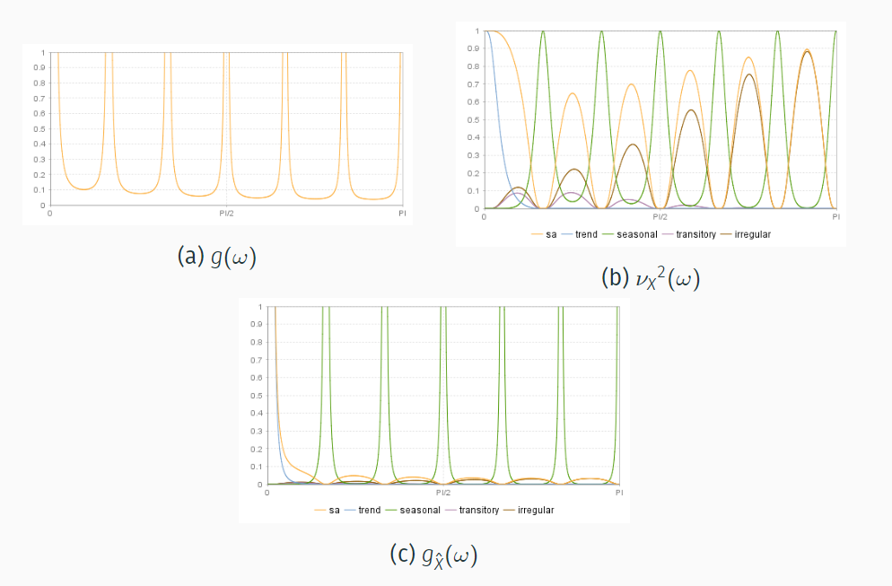
4.1 Analysis :Graphical representations

Slide 22
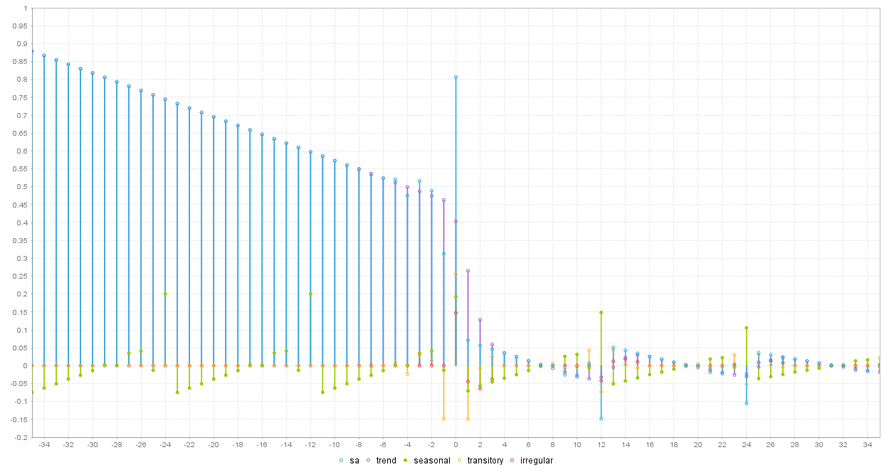
4.1 PsiE-weights
=Psi weights for estimators

Slide 23
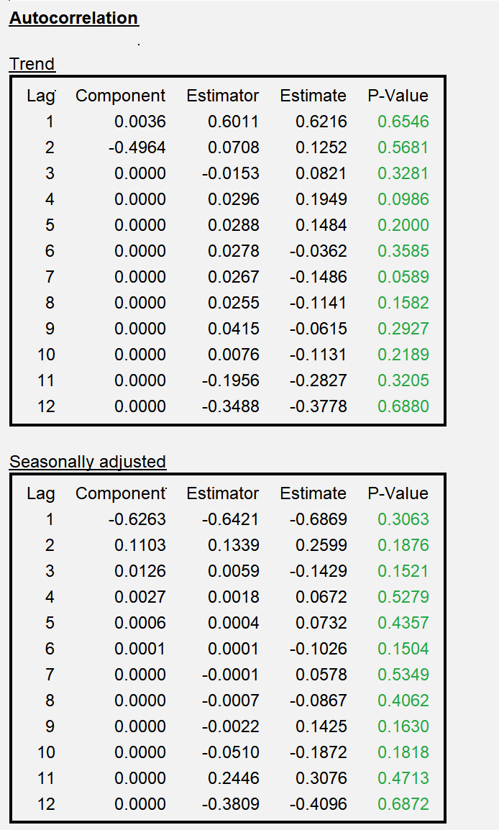
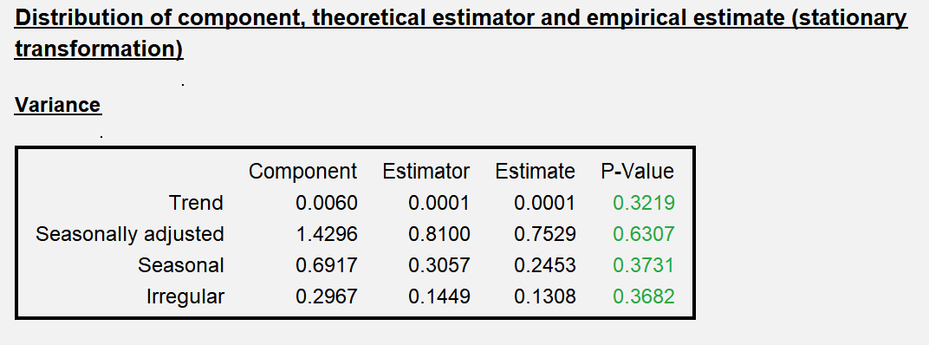
4.1 Properties of the components, estimators, estimates

Slide 24
4.2 Analysis
What matters?
  Understanding the differences between the “theoretical components” and their “estimators”
    For instance: “dips” in the spectrum of the estimator
  Understanding the properties of the estimators
    Model of Irregular ≠ white noise, negative ac(1) in many SA estimators, …
  Understanding PsiE-weights
    Revisions of the components = forecasts errors * PsiE weights
  Differences between the “final” estimator and the “concurrent” estimator
  Diagnostics: comparison of the properties of the estimators and of their estimates (variance, auto-correlations…)

Slide 25
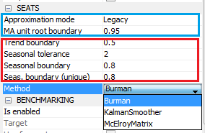
5. SEATS in JD+
Modification of the model
Decomposition of the model
Estimation of the components

Slide 26
5.1 SEATS in JD+ (cont.)
Impact of the parameters
  Only in case of AR polynomials
  k
    Small: possible « noisy » trend
    k ≈ 1: more stable trend
  e
    Large (>5): possible short term cycle in the seasonal (for instance, stochastic TD)→erratic seasonal
  l
    Small (<.8): higher risk of erratic seasonal
General consideration: threshold effects are unavoidable

Slide 27
5.2 Non decomposable models
Some models are not decomposable (often due to complex models)
  Best solution: change yourself the model (→airline)
  Otherwise:
    Legacy: Seats search for another SARIMA model, as similar as possible to the original model
    Noisy: Seats add noise in the initial model (→ I = Tr[= 0])

Slide 28
6. Final remarks
What matters?
  Impact of the model on
    SA/S “smoothness” ⇒ Be very careful with stationary AR roots
    Revisions
  Use PsiE-weights to understand/anticipate revisions
  Model-based diagnostics
    Variance estimators<> variance estimates
      Should not happen if the original model is well defined
      Be careful with non decomposable models / fixed models / “bad” models
  To go further, see:
    “SEASONAL ADJUSTMENT AND SIGNAL EXTRACTION IN ECONOMIC TIME SERIES”, by R. Gomez and A. Maravall

Slide 29
6. Final remarks (cont.)
Advantages and drawbacks of model-based decomposition
  +
    « Optimal filters », tailored for each series
    Many useful additional information (uncertainty…)
  -
    Might generate huge revisions
Some recommendations
  Fix the model
  Fix the SA in the past (5 years revisions)
  Fix the parameters and revise them when you revise the raw data
  Be pragmatic !

